Slide 1
The battle of Neighborhood
--Bloomington, IL

Slide 2
Background
Bloomington had a population of 76,610, making it the 12th most populated city in Illinois, and the fifth-most populous city in the state outside the Chicago Metropolitan Area. Combined with Normal, the twin cities have a population of roughly 130,000.

Slide 3
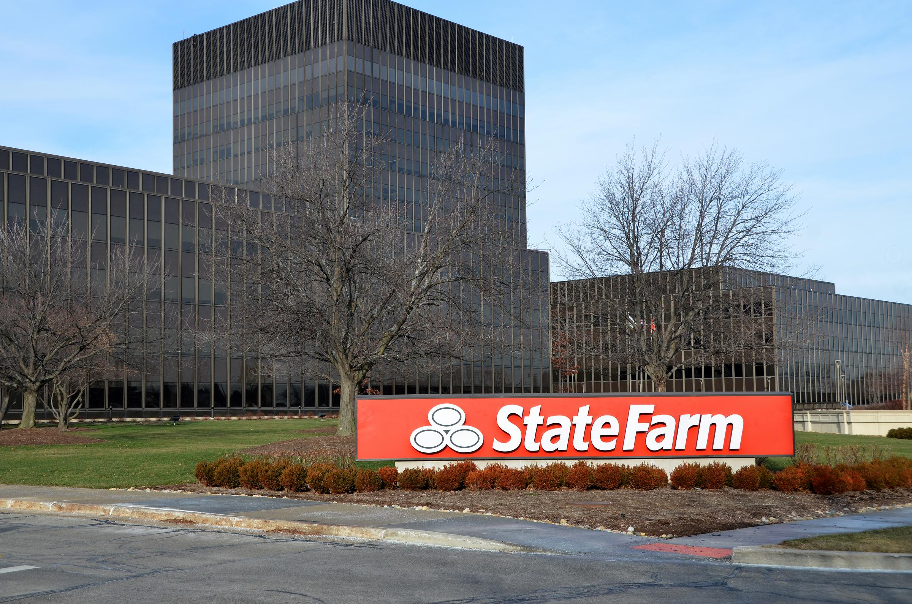
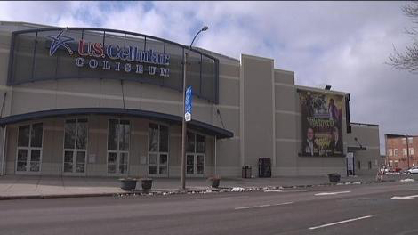
Background

Slide 4
Description of the problem
If a visitor comes to Bloomington and he likes outdoor activities and Chinese food, which neighborhood he should go. So he can play and eat well. The solution of the problem can be utilized in Bloomington’s city website as a guidance to the city.

Slide 5
Data
Neighborhood data scraped from NextDoor website
Latitude and longitude using geopy package in Python
Venues data from FourSquare API

Slide 6
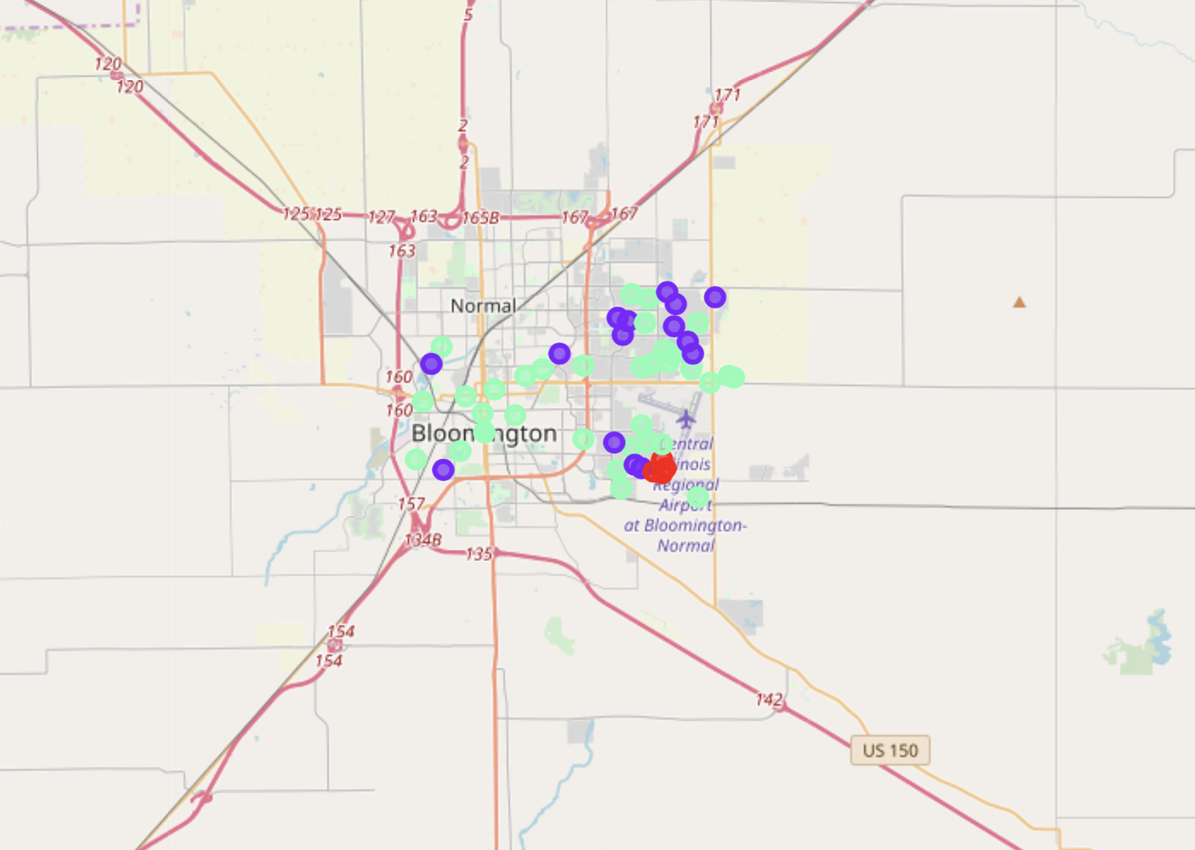
Methodology: K means

Slide 7

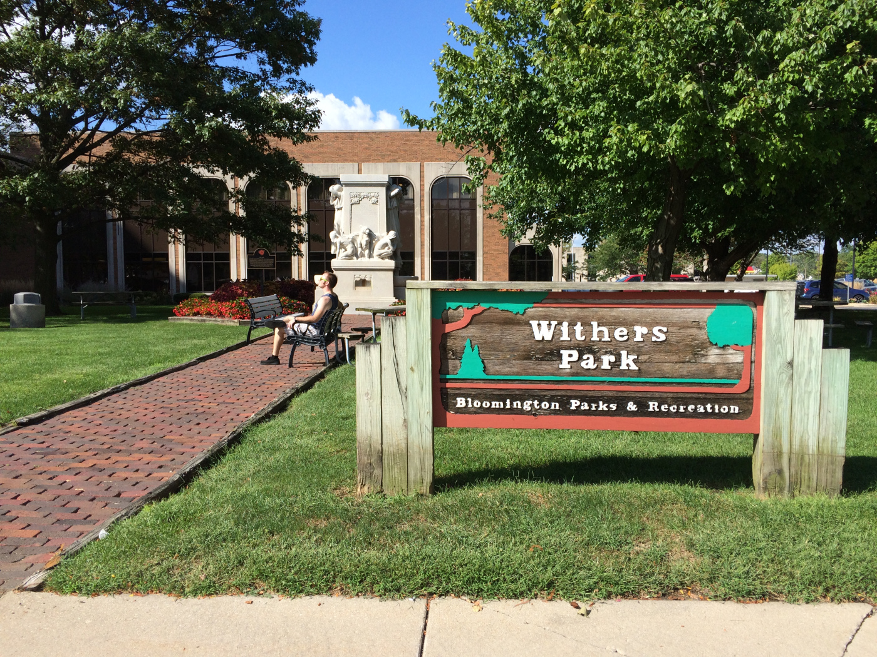
Result

Slide 8
Result
By searching for Chinese token inside the most common venue categories, it first appears in the
3rd Most Common Venue in neighborhood Clobertin Ct. Looks like Bloomington doesn’t have lots of Chinese restaurant. Clobertin Ct is the fourth neighborhood which has the most venues. Clobertin Ct’s two most common venue categories don’t have outdoor activities. So we need to find another neighborhood.
By looking through the ranked neighborhood based on venue count, E Grove ST is the fifth neighborhood and the 1st common venue is Park. So E Grove ST will be another recommended neighborhood.

